Slide 1


Artificial Intelligence
meets Branding
Ludwigshafen am Rhein, 14th of April 2025

Slide 2

Why, What and How

Slide 3
WHY
1
Artificial Intelligence is a key measure of the strategic lever "Accelerate" in the BASF strategy. Besides, the use of AI in our professional life is now a matter of course: it allows us an easier and more efficient way of working resulting best case in an augmentation of our communication.
In contrast, there is the danger of misusing AI tools with the goal to manipulate the public and to cause harm.
2
Thus, the "what" and "how" needs to be clarified and constantly adapted to currently fast-moving developments. To maximize the benefits of AI, mitigate risks and prevent potential disadvantages, legal, ethical and branding aspects must be considered.

Slide 4
WHAT
1
Evaluation of Artificial Intelligence Tools @ BASF
There are continuously a variety of AI tools tested and evaluated. The goal is to provide the community with a recommendation of AI tools.
Important: Always familiarize yourself with the terms and use and data protection of third party applications before sharing any (internal) information. As a rule of thumb, don’t share any internal information or higher with external providers unless there is an existing agreement between the provider and BASF.

Slide 5
WHAT
2
AI Governance - The Three Pillar Concept
Next to the tools, we must have a closer look to content being created by and/or with the support of AI. For the safe and compliant use of AI tools and its content creation, we developed a guiding framework based on three pillars Legal, Ethics and Branding.
Legal
Ethics
Branding
AI Act, art. 50, version 13.03.2024
Binding document "AI in Communication Contexts"
Necessity of labeling
1) deep fakes**
2) text published with the purpose of informing the public on matters of public interest
standardized identifier in the filename "_aga-YY-MM-DD“ *
Ethical considerations are part of current laws such as the AI Act and local legislation. BASF must ensure compliance with them.
In particular, the following aspects must be fulfilled:
1) The use of AI tools shall not harm human beings and must preserve human autonomy.
2) The use of AI must be fair, transparent and explicable.
The product/asset/content owner must make sure that communication assets such as text, visuals, audio and videos are compliant with the branding guidelines representing its DNA.
*aga = artificially generated asset

Slide 6
HOW
How to design AI-generated assets to strengthen the BASF brand
The continuously changing AI environment and an untransparent, complex legal situation, carry a potential risk that the BASF brand is harmed.
Two topics need to be evaluated regularly:
As intellectual property is ignored, there are an increasing number of legal cases where AI providers are sued (e.g. OpenAI).
Communication material generated by AI can’t be copyrighted at the moment, offering third parties the possibility to use it without legal consequences.
Due to the above mentioned cases, we recommend evaluating generated assets carefully.

Slide 7
HOW
How to design AI-generated assets in communication to strengthen the BASF brand
1. Filing of assets
In general, assets generated with/by AI must contain a label in the file name according to the following standard: _aga-YY-MM-DD.
2. Usage of assets
When embedding an AI-generated asset, for the moment, its origin does not have to be indicated.
Exception: a visible labeling on the asset itself is necessary if communication is
published with the purpose of informing the public on matters of public interest or
a deep fake (see BASF use cases AI in Brand Management).
The legal risk can be minimized by using visual content generated/manipulated by AI for internal purposes only.

Slide 8
Brand Portal
Artificial Intelligence in Brand Management

Slide 9
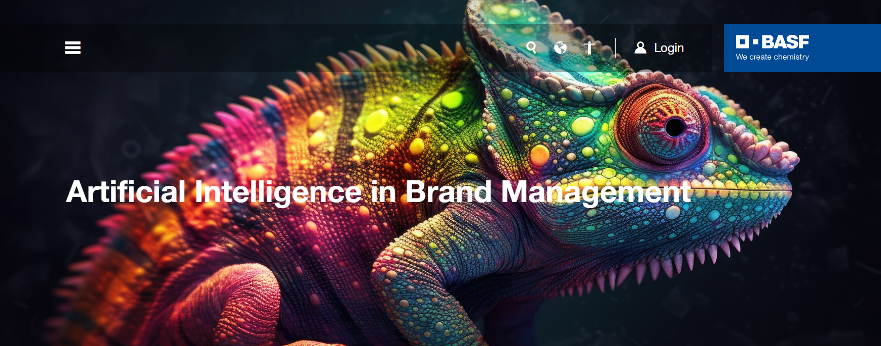
Brand Portal I Artificial Intelligence in Brand Management"
Link AI in Brand Management

Slide 10
Brand Portal I Summary BASF Use Cases
1
Images generated or manipulated by/with AI are only recommended if the exclusive use is irrelevant.
Reason: there is no copyright, third parties can use the image without any legal consequences.
Video and Audio Generation is allowed if the content is new and prompt-based.
Videos showing a person executing a simultaneous translation including lip synchronization represent a classic deep fake. These videos shall be labelled.
Text Translations: Note that BASF has no rights to the translation since it is AI generated. BASF cannot license it exclusively.
Text Generation: There is no copyright for the created text. The text can be used by third parties. This is only recommended if the exclusive use of the text is irrelevant to BASF.
AI Voice Audio Generation (e.g. talking avatar) represents a classic deep fake and shall be labelled.
There is no copyright for the created avatar with voice over.
Sound/Music Generation resp. entire Generation of a Music Piece. Audio generation is allowed if the result is new and prompt-based content. No imitation of existing audio styles or audio voice of famous singers or music, etc.
2
3
4
5
6
7

Slide 11
Take-aways for
Creators of Communication Assets

Slide 12
Take-aways for Creators of Communication Assets
Whenever you create communication assets, please consider the three pillars
Please inform yourself proactively. The seven use cases represent ~ 80% of current BASF cases giving you first guidance.
Legal & ethics
Inform yourself regularly about your regional legal framework.
Partner early in the project with your regional legal counsel.
Mindset change: “Tell me how to do it, not how not to do it.“
Branding - include your respective consultant.
Note: Neither Brand Consultancy nor Legal can take away the last risk from the consulted party.
The consulted party must decide for itself and bear the full responsibility.
Legal
Ethics
Branding

