Slide 1


Web Accessibility x Visual Style
Color contrast
January 23, 2025

Slide 2
For content shared digitally, there are many guidelines that exist to make sure that we communicate clearly
to the widest possible audience.
The following pages explain the two most relevant to presentation design and the measures required to be inclusive.

Slide 3

Key ratios of contrast
Users, including users with visual disabilities, must be able to perceive content on the page
Colour contrast is vital to accessibility, and this is simply how well text or graphics stand out from their background
There are three key ratios to be aware of, as shown here with example combinations, each defines what the degree of contrast may be used for
≥7:1
Colour combinations with
a contrast ratio of 7:1 or greater may be used for
all text sizes, icons, and graphics
≥4.5:1
Combinations with a contrast ratio of 4.5:1 or greater may be used for ‘large text’, defined as text
14pt (18px) and larger when bold, or at least 18pt (24px) otherwise
≥3:1
Contrast ratios of at least 3:1 may only be used for icons and graphics
<3:1
Ratios of less than 3:1 are only suitable for decoration, not communicating content
Text that is part of a logo or brand name has no contrast requirement

Slide 4
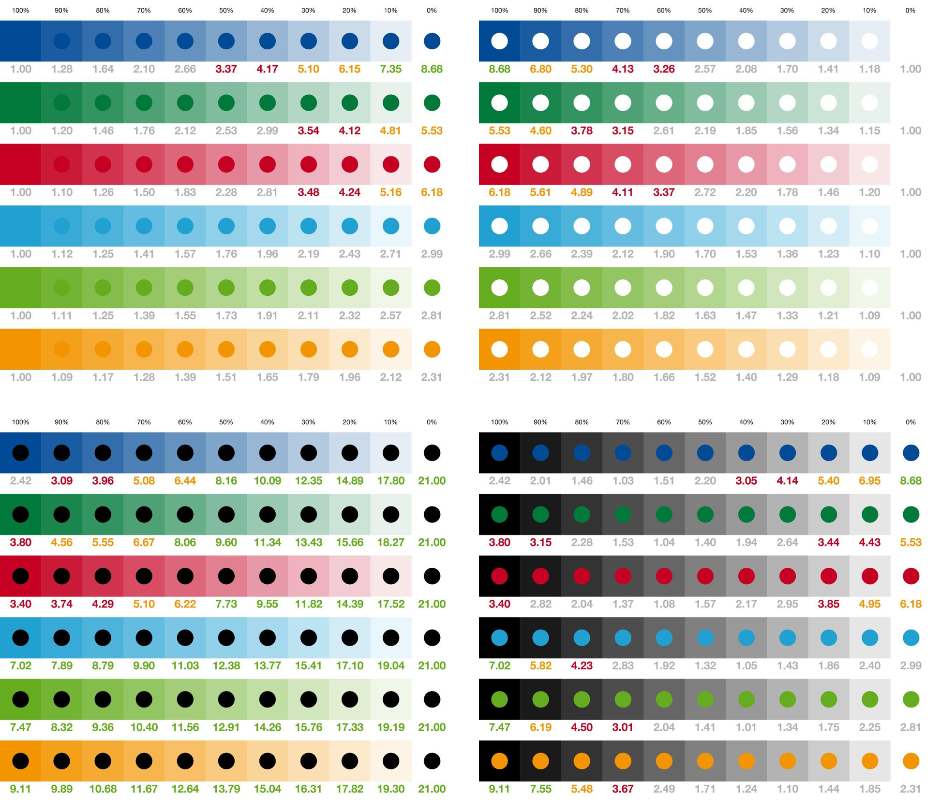
Contrast ratios with our Corporate colours
Further to research already conducted by BASF, this extensive data reveals the contrast ratios of our six brand colours and their tints, with themselves, white, and black
The figures shown can be decoded to create a set of accessible colour combinations for displaying text
The three darker colours and three lighter colours perform similarly to each other, as shown on the following results pages

Slide 5
Colour contrast
Black on
white
Dark grey (≥80% black) on
white
Black on
white
Dark grey (≥80% black) on
white
Black on
white
Dark grey (≥80% black) on
white
≥7:1
Black on
≤50% Dark Blue
Black on
≤50% Dark Green
Black on
≤50% Red
These are colour combinations with a contrast ratio of 7:1
or greater
They may be used for all text sizes and types
Dark grey (≥80% black) on ≤10% Dark Blue
Dark grey (≥80% black) on ≤10% Dark Green
Dark grey (≥80% black) on ≤10% Red
Black on
Light Blue (all tints)
Black on
Light Green (all tints)
Black on
Orange (all tints)
Dark grey (≥80% black) on ≤10% Light Blue
Dark grey (≥80% black) on ≤10% Light Green
Dark grey (≥80% black) on ≤10% Orange

Slide 6
Colour contrast
≥4.5:1
Dark Blue on
white
Dark Green on
white
Red on
white
These are colour combinations with a contrast ratio of 4.5:1
or greater
They may be used for ‘large text’, defined as text 14pt (18px) and larger
when bold, or at least 18pt (24px) otherwise
Text colour combinations not shown here or on the previous page should be avoided because other combinations would be untested for accessibility
Dark Blue on
≤10% Dark Blue
Dark Green on
≤10% Dark Green
Red on
≤10% Red
Black on
≤70% Dark Blue
Black on
≤70% Dark Green
Black on
≤70% Red
White on
≥90% Dark Blue
White on
≥90% Dark Green
White on
≥90% Red
Black on
Light Blue (all tints)
Black on
Light Green (all tints)
Black on
Orange (all tints)

